Slide 1

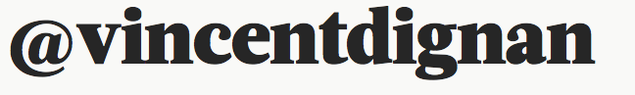

vincent@magnific.com

Slide 2


Slide 3












Slide 4
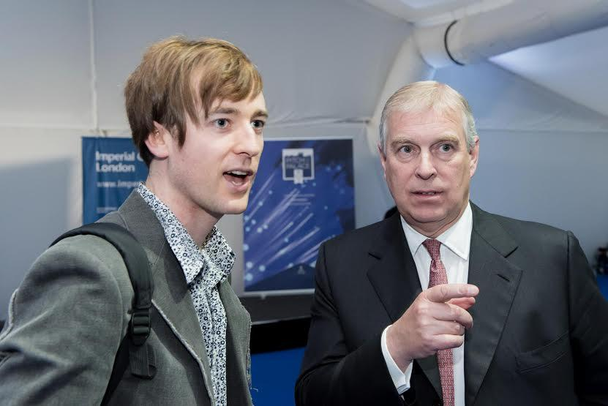
Me, by royal appointment

Slide 5
150,000,000+ Total Pageviews
50 million+ unique visitors
200,000+ Likes/followers
50,000 client followers
1000’s of signups

Slide 6
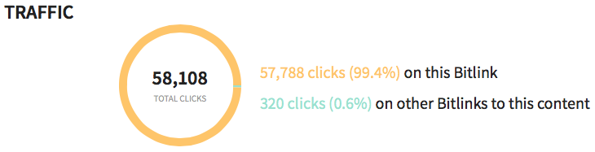

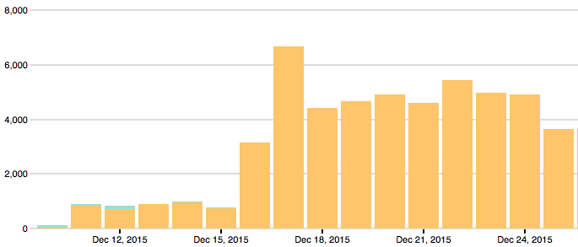

Slide 7
SubTV - Zero to 50,000 visitors a month in 5 months
Chainy - Community building - 0 to 15k Twitter followers in 5 months
A cooking app - zero to 100-200 downloads a day within the first 30 days
Training, coaching, consultancy

Slide 8
AGENDA
What is growth hacking?
How to growth hack IRL/social
Activity: Finding customers on Twitter
Social news, email
Productivity, psychology, and more
(Content marketing on next page)

Slide 9
What is growth hacking?
“A marketing technique initially employed in tech startups that uses creativity, social metrics and analytical thinking as well as tools to sell products and gain exposure.”

Slide 10
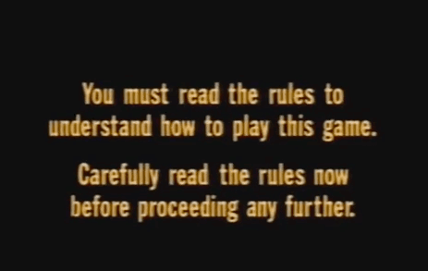
The golden rules of growth

Slide 11
The golden rules of growth
Scalable

Slide 12
The golden rules of growth
Scalable
Repeatable

Slide 13
The golden rules of growth
Scalable
Repeatable
Predictable

Slide 14
The 10 rules of growth hacking
“Grow fast or die slow” - Samir Patel

Slide 15
The 10 rules of growth hacking
“Grow fast or die slow” - Samir Patel
You do not talk about growth hacking

Slide 16
The 10 rules of growth hacking
“Grow fast or die slow” - Samir Patel
You do not talk about growth hacking
You do not talk about growth hacking (investors/public)
Read: http://bit.ly/songkickgrowthhack

Slide 17
The 10 rules of growth hacking
“Grow fast or die slow” - Samir Patel
You do not talk about growth hacking
You do not talk about growth hacking
Speak to customers & define messaging before you go viral
Read “The Mom test” (I can send it to you)

Slide 18

UX: “If the user can’t use it, it doesn’t work”
UX
9

Slide 19
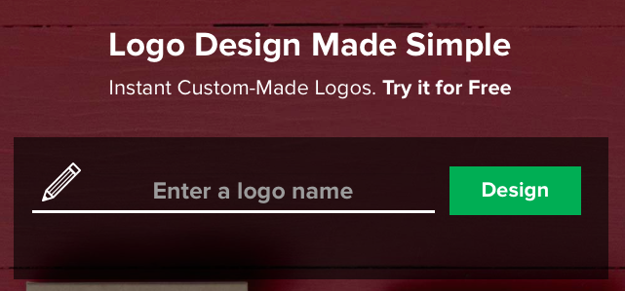
0. Tailorbrands.com: Create a free logo today!
Also: Logaster.com

Slide 20
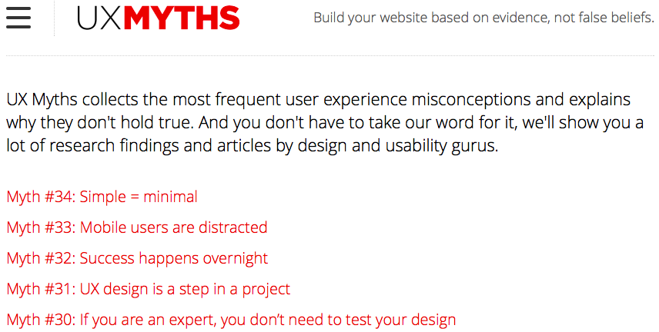
1) UXMYTHS.COM - Don’t believe the hype

Slide 21
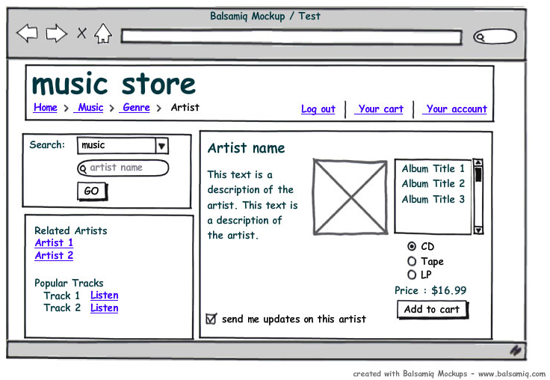
2) Balsamiq creates mockups the easy way

Slide 22
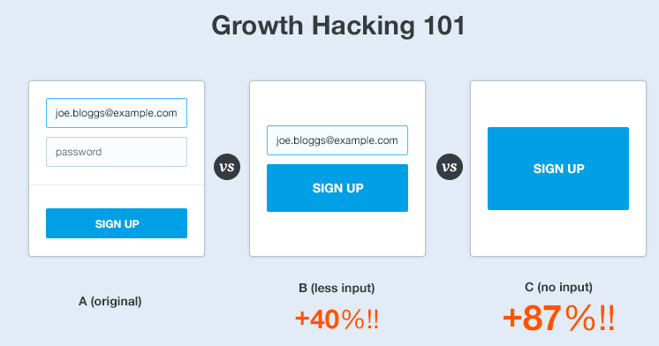
3) KEEP YOUR SIGNUP TOTES SIMPLE
-One thing to type into/click only!

Slide 23
3.5) Keep user onboarding easy
1) Auto-login after signup
Jump right into product :)
2. Send personal email
Within 24 hours (or even right away), send them a personalized email asking them specifically why they signed up.What made them pull the trigger? This is extremely important data as you want to make sure that your product is delivering what your marketing messages are promising.

Slide 24
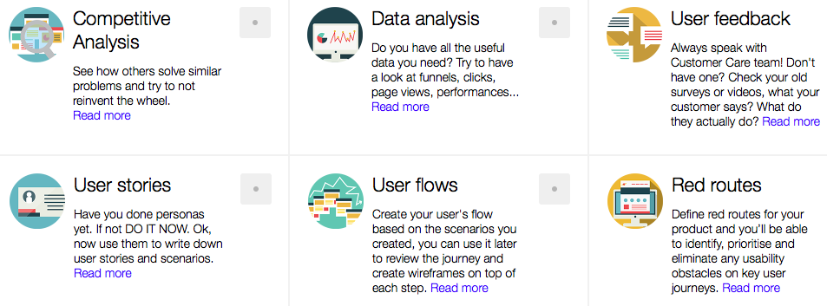
4) UX CHECKLIST via Github: http://bit.ly/UXPLZ

Slide 25


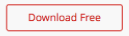

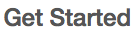
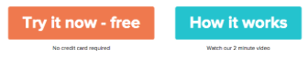
5) The 5 best call-to action buttons
1)
2)
3)
4)
5)

Slide 26
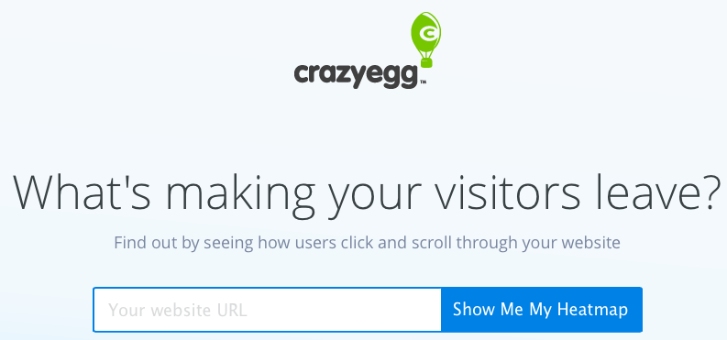
6) See where your visitors hover/click
http://bit.ly/cr8zyegg - Free 90 day trial!

Slide 27

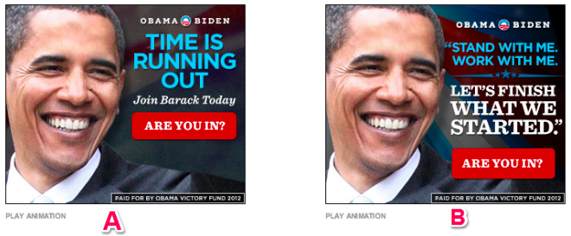
7) helps you A/B test key messaging

Slide 28
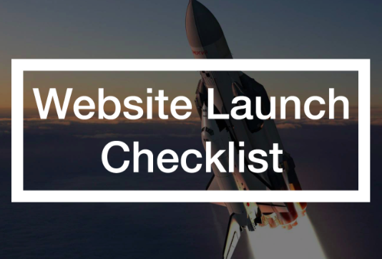
8) You need this website checklist in your life:
http://bit.ly/ch3cklist

Slide 29
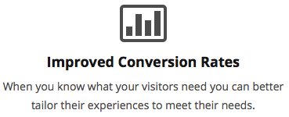
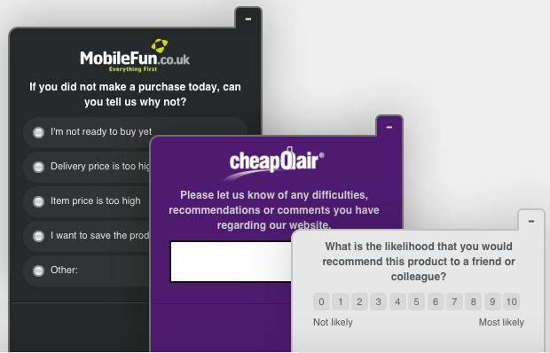
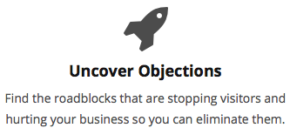
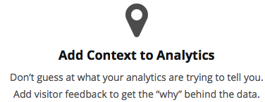
9) Analytics tells you what people do on your
site. Qualaroo tells you WHY

Slide 30
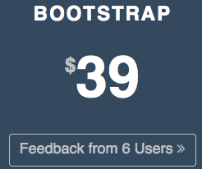
10: Test your site
with just 5 different people
“5 users can pick up 85% of User Experience Issues” -Neilsen Study
http://usersthink.com

Slide 31
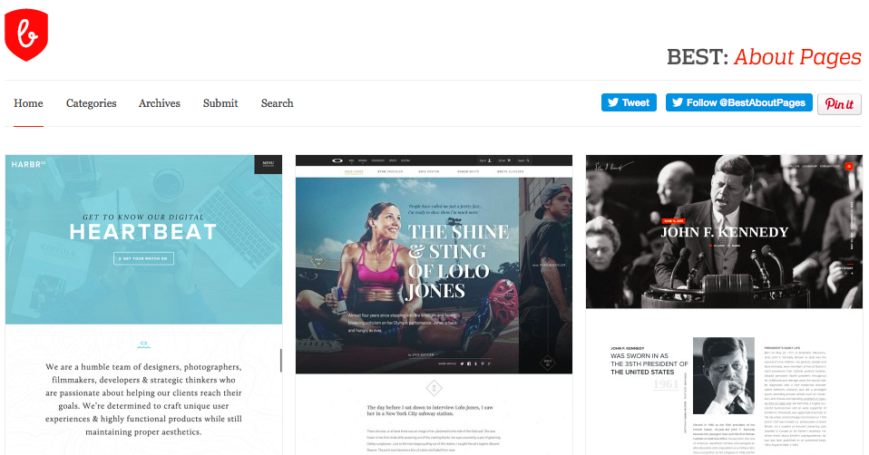
Bestaboutpages.com

Slide 32

UX SECTION COMPLETE!

Slide 33
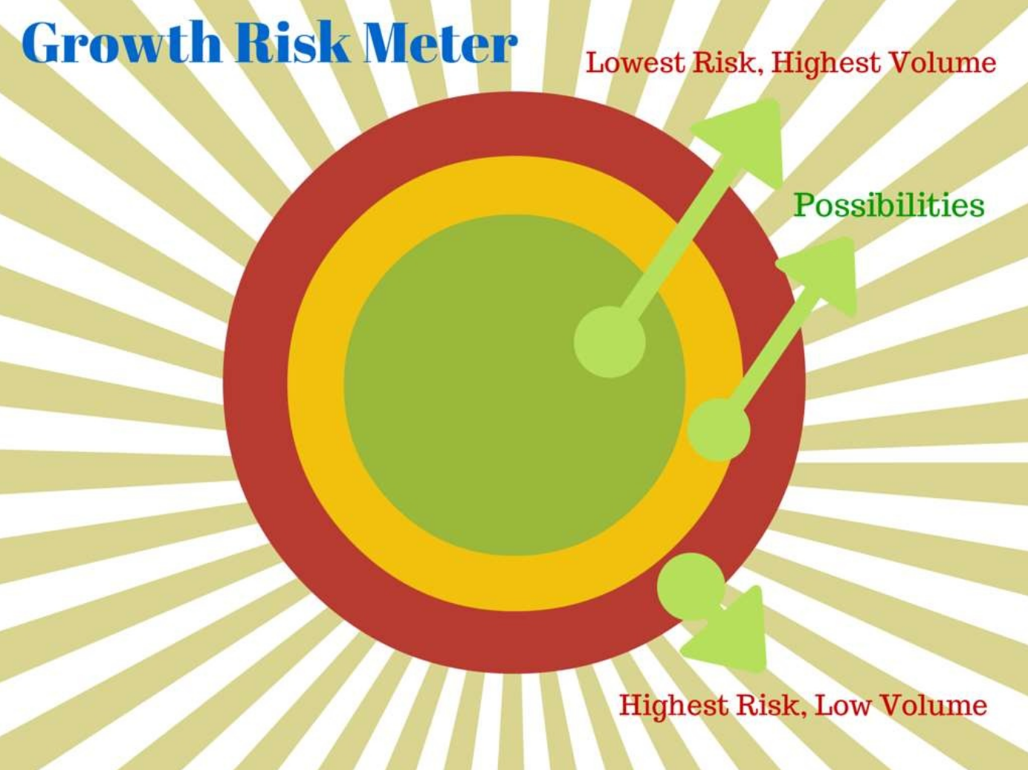
The 10 rules of growth hacking
“Grow fast or die slow” - Samir Patel
You do not talk about growth hacking
You do not talk about growth hacking
Speak to customers & define messaging before you go viral
Investigate & map channels easiest - hardest

Slide 34
The 10 rules of growth hacking
“Grow fast or die slow” - Samir Patel
You do not talk about growth hacking
You do not talk about growth hacking
Speak to customers & define messaging before you go viral
Investigate & map channels easiest - hardest
Set S.M.A.R.T. goals
Specific
Measurable
Achievable
Relevant
Time-based

Slide 35
The 10 rules of growth hacking
“Grow fast or die slow” - Samir Patel
You do not talk about growth hacking
You do not talk about growth hacking
Speak to customers & define messaging before you go viral
Investigate & map channels easiest - hardest
Set S.M.A.R.T. goals
Read the basics for your channel(s) on growthhackers.com
https://growthhackers.com/must-read/

Slide 36
The 10 rules of growth hacking
“Grow fast or die slow” - Samir Patel
You do not talk about growth hacking
You do not talk about growth hacking
Speak to customers & define messaging before you go viral
Investigate & map channels easiest - hardest
Set S.M.A.R.T. goals
Read the basics for your channel(s) on growthhackers.com
Don’t sweat the small things on day one

Slide 37
The 10 rules of growth hacking
“Grow fast or die slow” - Samir Patel
You do not talk about growth hacking
You do not talk about growth hacking
Speak to customers & define messaging before you go viral
Investigate & map channels easiest - hardest
Set S.M.A.R.T. goals
Read the basics for your channel(s) on growthhackers.com
Don’t sweat the small things on day one
Be a mixture of mad men & math men

Slide 38
The 10 rules of growth hacking
Be a mixture of mad men & math men:
The $9 Marketing Stack
Analytics
Segment (free for 100,000 events/mo) Single hub to collect, translate & route your customer data
Google Analytics (free as in beer)
Mixpanel (free for 25,000 events/mo; 200,000 events with badge)
A/B Testing
Optimizely (free for 50,000 uniques/mo)
Marketing Automation (opt-in forms, email marketing, automation, and CRM)
ActiveCampaign ($9/mo for 3 users; used to be free)
Scrollbox by SumoMe (free) for pop-up lead capture on the blog or sales site
Perfect Audience (free to signup; CPM billing) for retargeting

Slide 39
The 10 rules of growth hacking
“Grow fast or die slow” - Samir Patel
You do not talk about growth hacking
You do not talk about growth hacking
Speak to customers & define messaging before you go viral
Investigate & map channels easiest - hardest
Set S.M.A.R.T. goals
Read the basics for your channel(s) on growthhackers.com
Don’t sweat the small things on day one
Be a mixture of mad men & math men
Pour more resources into the one(s) that work

Slide 40
The 10 rules of growth hacking
“Grow fast or die slow” - Samir Patel
You do not talk about growth hacking
You do not talk about growth hacking
Speak to customers & define messaging before you go viral
Investigate & map channels easiest - hardest
Set S.M.A.R.T. goals
Read the basics for your channel(s) on growthhackers.com
Don’t sweat the small things on day one
Be a mixture of mad men & math men
Pour more resources into the one(s) that work
Rinse & repeat - Think like Airbnb/Buzzfeed/Genius

Slide 41
The 10 rules of growth hacking
“Grow fast or die slow” - Samir Patel
You do not talk about growth hacking
You do not talk about growth hacking
Speak to customers & define messaging before you go viral
Investigate & map channels easiest - hardest
Set S.M.A.R.T. goals
Read the basics for your channel(s) on growthhackers.com
Don’t sweat the small things on day one
Be a mixture of mad men & math men
Pour more resources into the one(s) that work
Rinse & repeat - Think like the americans

Slide 42
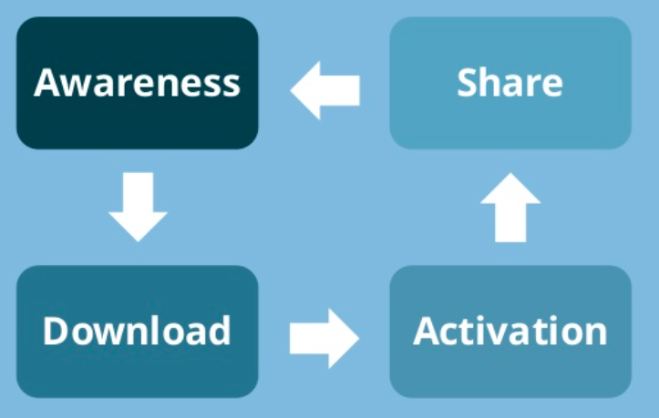
Typical growth engine (for an app)

Slide 43
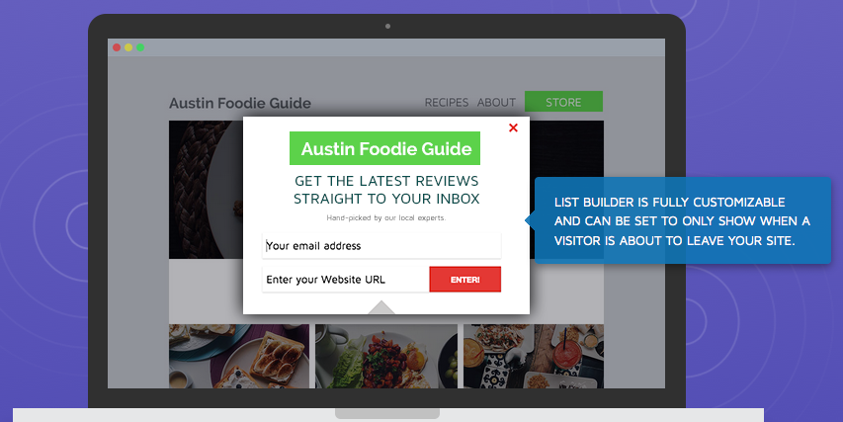
Sumome.com - Awesome widgets, no code

Slide 44
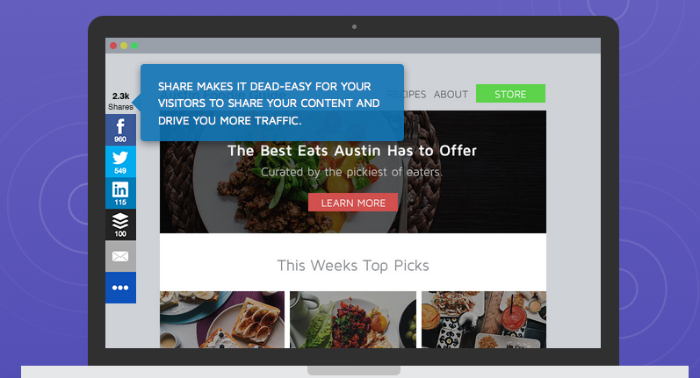
Sumome.com - Awesome widgets, no code (2)

Slide 45
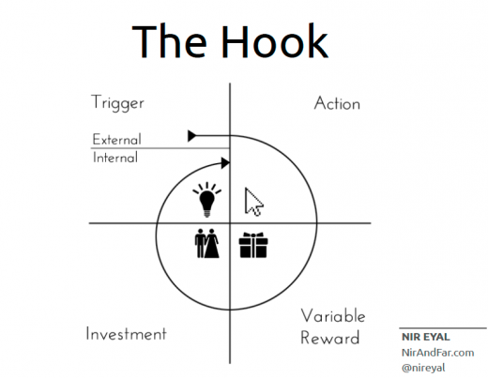
The secret formula to getting returning users:

Slide 46

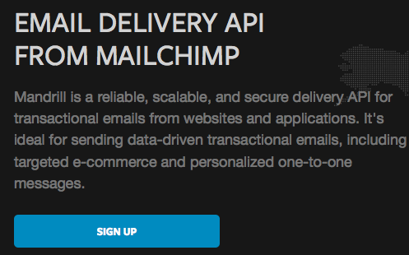
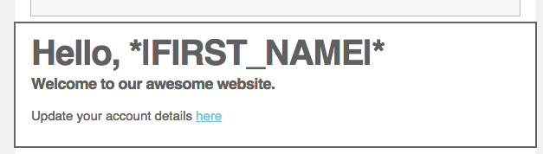
Automate emailing users when something happens (signup, unfinished basket, etc)
=

Slide 47
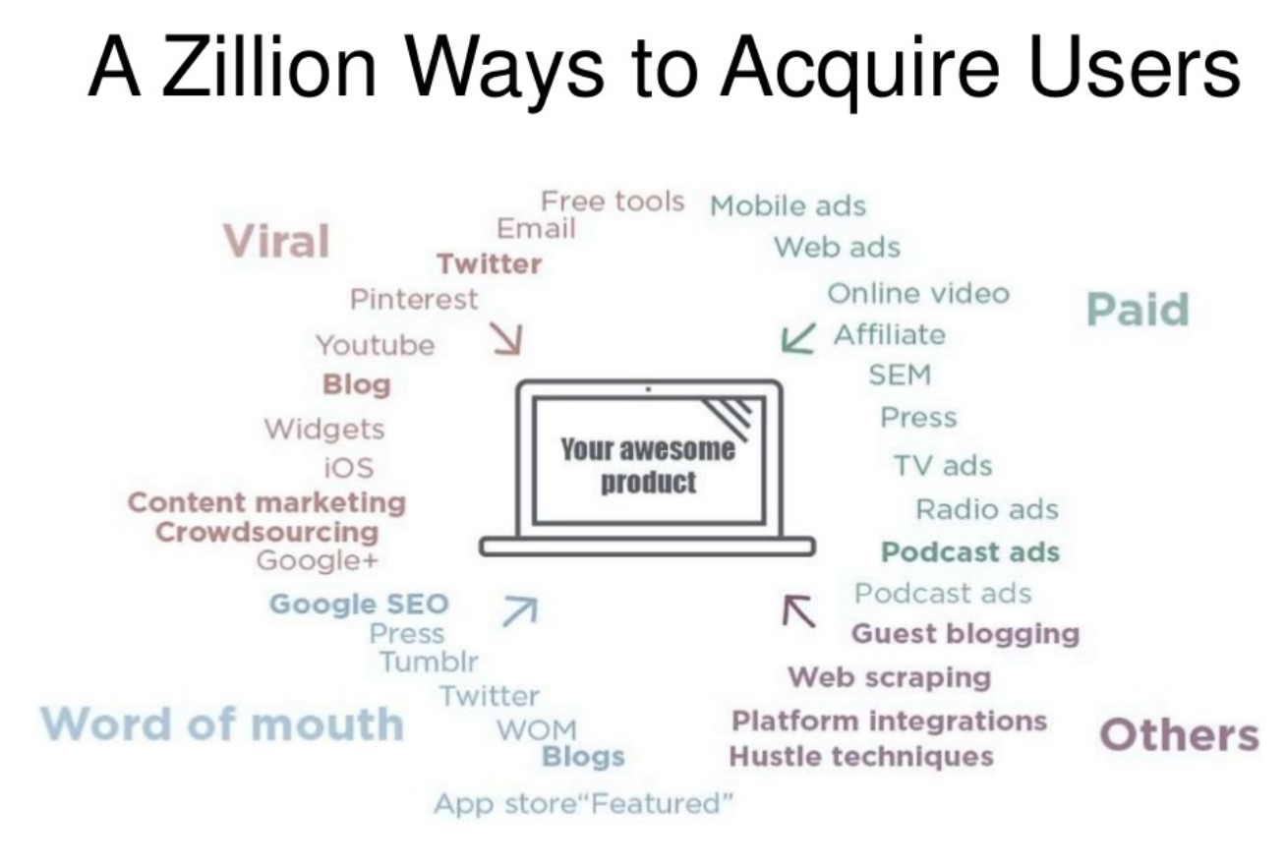

Slide 48
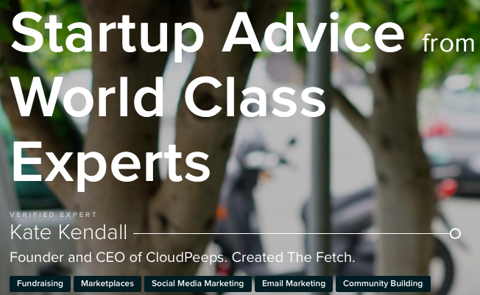

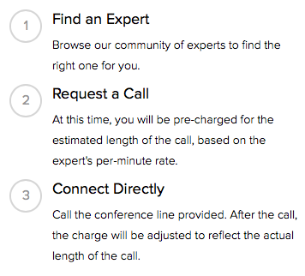
YOU HAVE NO IDEA WHAT THE F YOU’RE DOING (and that’s fine)

Slide 49
19 main channels of user acquisition:
Sales
Existing Platforms
Trade Shows
Offline Events
Offline Ads
More info here
Content Marketing
Email Marketing
Engineering as Marketing
Business Development
Affiliate Programs
Viral Marketing (customer invites)
Community Building
Targeting Blogs
Publicity
Unconventional PR
SEO/SEM
Social and Display Ads
Speaking Engagements

Slide 50
My preferred channels of user acquisition:
IRL
Social Media
Content Marketing :(
Email Marketing + Bonuses?

Slide 51

This is your site if you have no pre-launch game:

Slide 52

“Boring” startups can growth hack too

Slide 53
Mint.com (Acquired in 2 years)
9 month pre-launch strategy
Lots of written content and infographics to be shared on Reddit, Digg, Facebook etc
Q & A’s with Finance bloggers (or Technology journalists with a big reach)
Email box at the end of every single blogpost - Acquired 20k-30k emails
To get mint first, bloggers put the “I want mint” badge on their blog
Founder spent one week out of every two months on a press tour (disclaimer: They hired a PR agency to help with this, but you can do press without) - PR sometimes added 20,000 signups a day post-launch
“Mint answers” section answered questions about finance (by experts)
SEO “For every popular finance query on Google, we had a page and content for it, and iterated landing pages to optimize conversion.””
Cost of user acquisition was under $1

Slide 54

Get your skates on & hustle

Slide 55
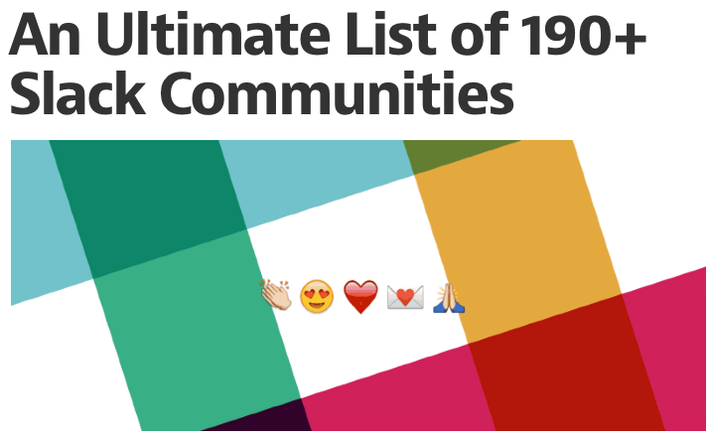

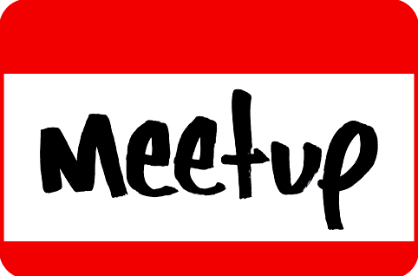
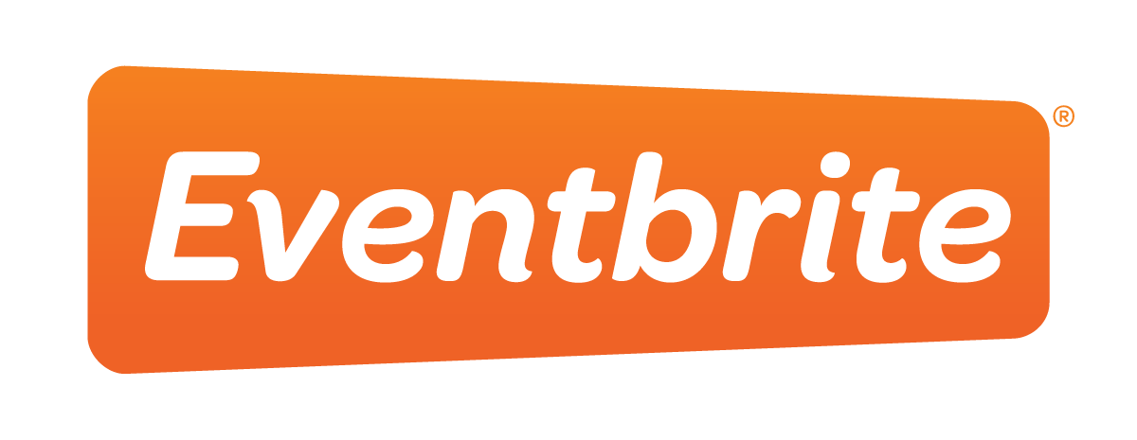
Day 1 Feedback: http://bit.ly/5lack

Slide 56
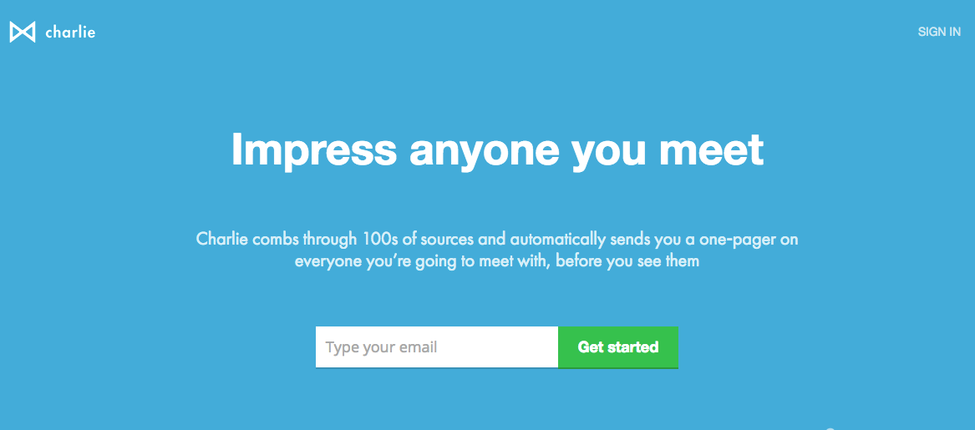

Use Charlieapp.com

Slide 57
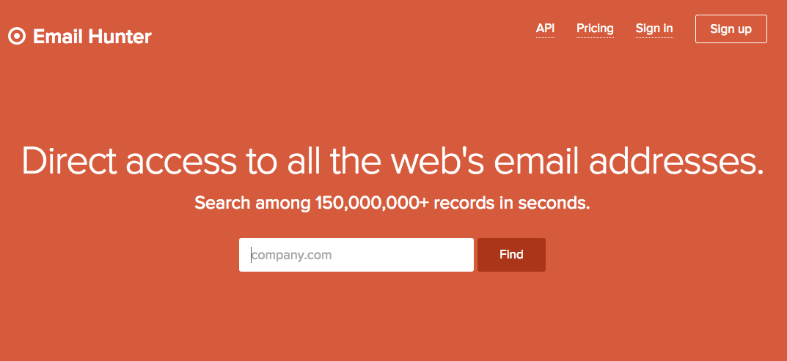
Become a hunter gatherer (of emails)

Slide 58
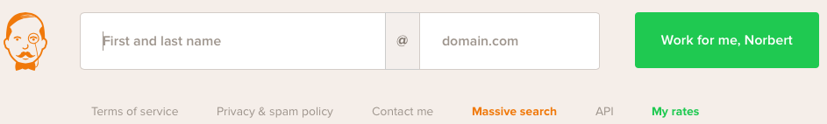
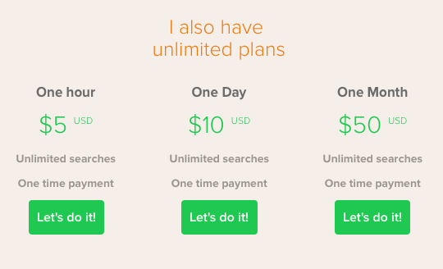
Voila Norbert: Find anyone’s email address

Slide 59
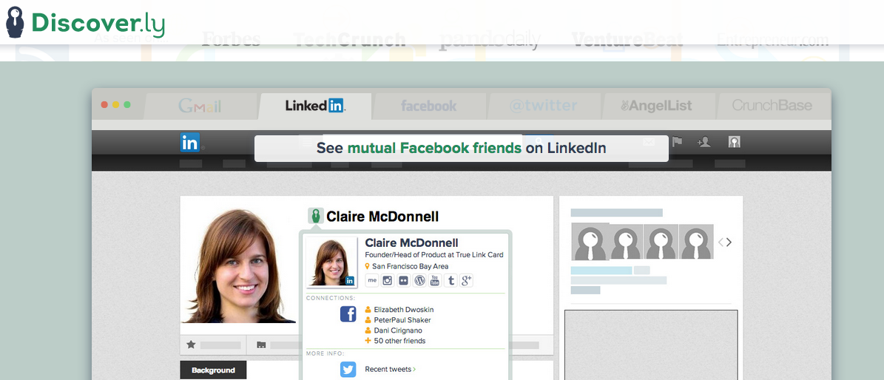
We are all connected

Slide 60
IRL Types of businesses
- Anything “sales” driven
- Business that rely on relationships
- A good first step if you don’t already know where to find your users

Slide 61

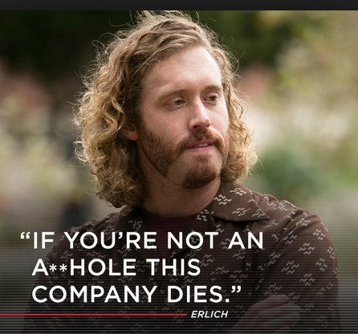
This phone phobia must end
*Learn how to brain drain

Slide 62

Breathe. Stretch. Any Questions?

Slide 63
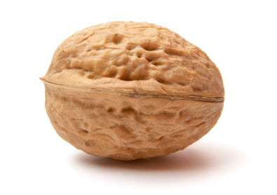
Social Media:
1. Get a following
2. Broadcast to them
3. Reap the benefits
4. Profit?!?!?!?

Slide 64


Slide 65
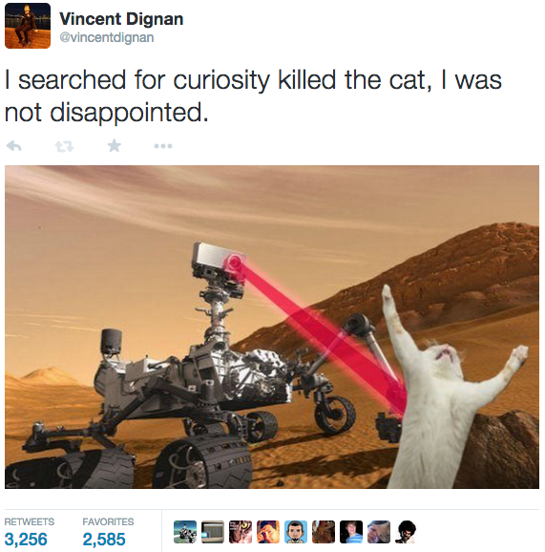

Slide 66
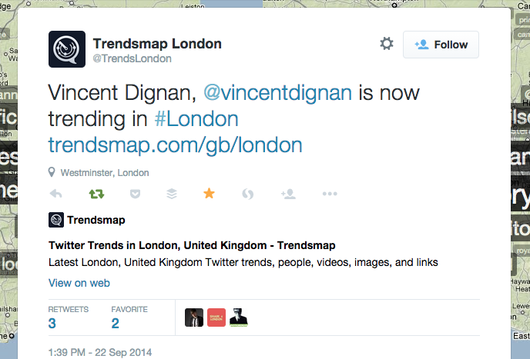
Momma I made it!

Slide 67
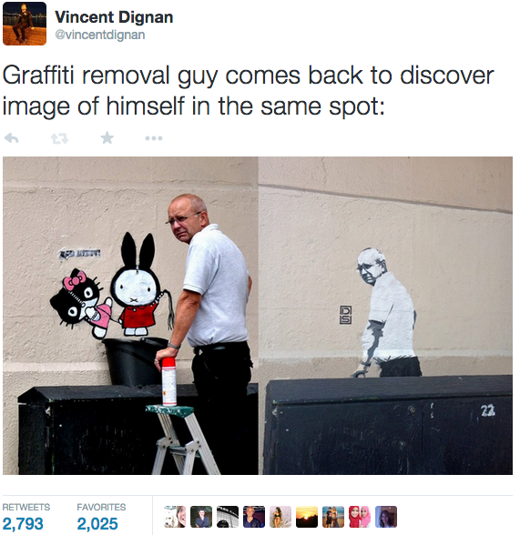

Slide 68
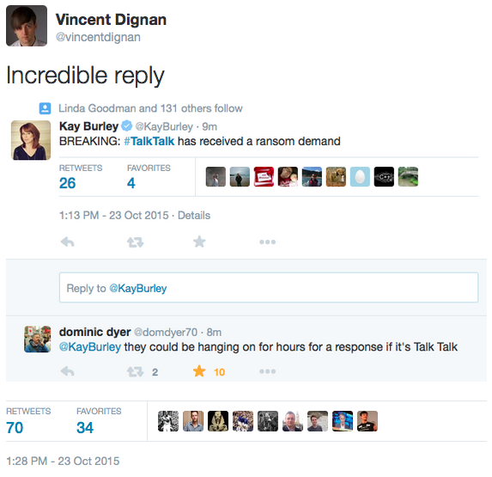

Slide 69
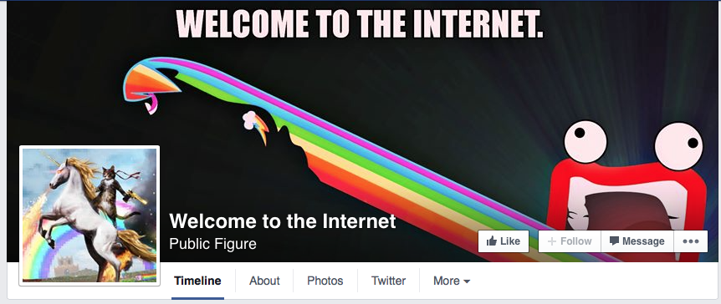

Slide 70
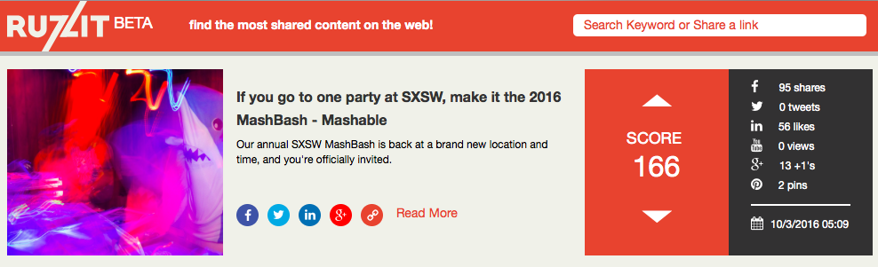
Ruzzit.com - Viral content aggregator

Slide 71
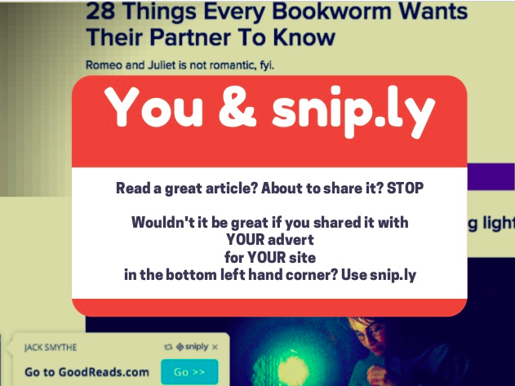

Slide 72

Ideal User is critical
Reply and flood hashtags
Who says Instagram gets no clickthroughs?
Read: https://blog.gleam.io/foundr/
http://austenallred.com/user-acquisition/book/chapter/instagram/

Slide 73
Who says Instagram gets no clickthroughs?
Create a quick, to-the- point bio (150 characters or less) followed by a direct CTA that uses a memorable URL.
Use something like www.yourcompany.com/go or www.yourcompany.com/startnow. The link should take users to a unique page so you can track traffic you are generating on Instagram. This page should offer them INSANE VALUE
Put your URL/emojis in your location!

Slide 74
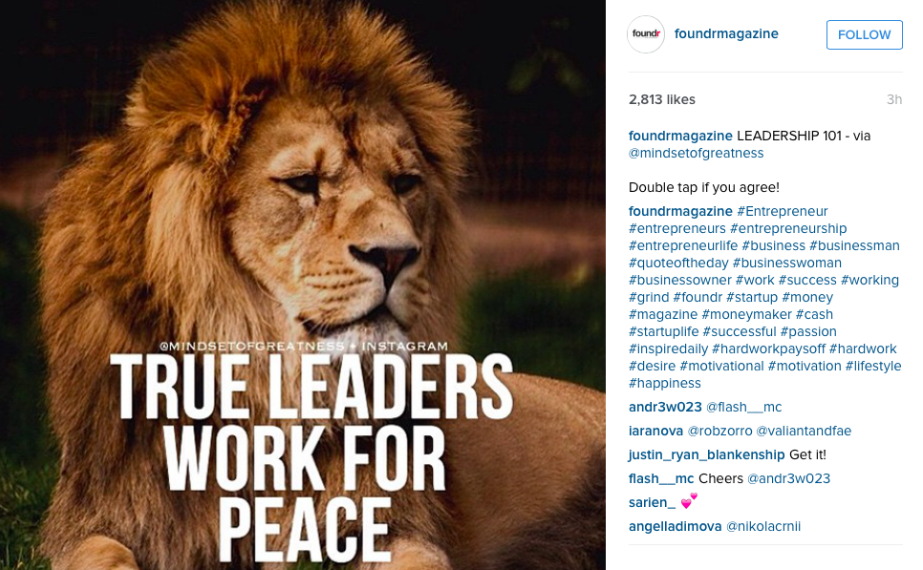

Scheduling posts on Instagram!

Slide 75


Some (girls) have all the power on IG

Slide 76


Slide 77

Making HOT Instagram posts
Use Canva.com (desktop),
or Text Cutie (app) to make posts
Use Hootsuite or Buffergram
to schedule Instagram posts
3. http://websta.me/hot will help
you find hashtags

Slide 78
Businesses who may need Instagram
Anything with a “product” that looks cool e.g. fashion, technology, personal brand,
Apps/Software/Platforms looking to get a large (as in tens of thousands) userbase
Anyone “building a brand”

Slide 79

6.
Make your posts public!
Add me on Facebook here: Vincent Dignan

Slide 80
Your Facebook Group: Get 1,000 members in 30 minutes
1) Create group, image, description, etc
2) Click "Add people to group" on top right
3) Press "a" key to bring up all of your friends who start with the letter a, click them one by one, eventually after selecting 8 or so it will say it is full.
4) Then type "b" and click all of those, and so on, all the way through the alphabet
5) When you get to z, add a vowel to each letter, so firstly "ao", "bo", "co" etc
6) Repeat for a, e, i, and u after the first letter
7) This will cover 95% of you and your co-founders friends lists, and you're done

Slide 81


Slide 82



Slide 83


Custom Audiences is how you Facebook Ad:
Spaceship.rocks simplifies this
Export competitors followers
Turn them into emails
Use emails?
Feed into Facebook/Twitter
as ads

Slide 84
Businesses who may need Facebook
Anything with a “product” that you can arbitrage sales in the same way as adwords
This can include apps in certain situations
Basically everyone to a certain extent: Add the line of retargeting code (+ Google’s) :-(
Fanpagekarma.com - track other FB pages so you can see which posts got the most traction

Slide 85


Slide 86


Slide 87


Slide 88


The best Twitter tool of all time
Search by gender, job title, location,
company/person - mad targeting

Slide 89

Activity: Finding your customers

Slide 90


Slide 91

Type your ideal user in this box!

Slide 92


Slide 93

Tweepi will get you followers.

Slide 94


Slide 95
Twitter basics
1. Steal the good stuff, only RT compliments
2. Tweet the same (article) 5 times
3. Pictures most likely to be retweeted
4. Tweet lots: 50 - 100 tweets a day is fine
5. Tweepi gets you followers literally today

Slide 96
Businesses who may need Twitter
Apps/Software/Platforms looking to get a large (as in tens of thousands) userbase
Businesses where content is important
Anyone looking to reach a certain job title/location (basic demographics, Facebook needed for complex targeting)
Events businesses

Slide 97

Businesses who may need Tumblr
Anything youth orientated
Anything aimed at
America/worldwide
and youth orientated
Fashion/music
(Dm’s are the key)

Slide 98
Businesses who may need Pinterest
Anything beautiful, aimed at females 30+
Use Buffer to easily setup a pinning schedule
Remove any pin with less than 6 repins within 48 hours (Pinterest algorithm)
Groups are easiest way to reach thousands
Difficult to work out, so likely a big opportunity here

Slide 99



Finding Influencers:

Slide 100


Finding Influencers (2)

Slide 101

Reach YouTube Influencers with Famebit. YouTube ads can work too.

Slide 102


Post to multiple LinkedIn groups at once!
https://www.linkedin.com/shareArticle?mini=true&url=http://yourwebsitehere.com

Slide 103


Top Linkedin channels by followers:
Find some Linkedin groups to post into here.

Slide 104
How to get your first 500 users (125 signups per social network, takes an afternoon) - ASSETS
Message LinkedIn contacts in batches of 20 using the link I just sent you
Individually message all of your Facebook friends
Tweet @ all of your Twitter followers one by one (Buffer can help you do this quicker)
Email all of your contacts one by one (we’ll get into this later)
Read this

Slide 105

LinkedIn Hack
Build a robot that looks at people’s profiles
- 15,000 views a day = 9,000 people looking at your own LinkedIn page!

Slide 106

BEGINNING ACTIVITY - Search for your niche, find 10 subreddits to post in to

Slide 107

Useful Subreddits
r/startups - r/entrepreneur - r/smallbusiness
r/engineering - r/hwstartups
r/AlphaAndBetausers (submit your app for feedback)
Marketing Advice: r/marketing, r/seo, r/bigseo, and r/askmarketing
Technical Advice: r/wordpress, r/iosprogramming, and r/androiddev
Learning: r/learnprogramming

Slide 108
Businesses who may need social news
Anything where “tech” feedback is important
Anything where techy early adopters are important
Apps/Software/Platforms looking to get a large (as in tens of thousands) userbase can seed initial users here

Slide 109
Snapchat, Periscope, WhatsApp
Periscope: Getting very important if your company is your personal brand: Download this
Snapchat: Great for real-life event promotions and flash sales/youth brands. ROI questionable
WhatsApp: If you can live with yourself

Slide 110

Social media level complete? Questions?

Slide 111


Slide 112


Slide 113


Slide 114


Slide 115


Slide 116



Slide 117


Slide 118

Here comes a new challenger!
Meetedgar.com & Smarterqueue loop updates

Slide 119
SEO is not dead - it just smells funny
Google’s guide to SEO here
MOZ guide to SEO here
Slideshare guide here
2. Site design is critical - Analytics, Webmaster tools, SEO settings
3. Find your keywords using this
4. Main 200 signals here

Slide 120




SEOhmygod you need this stuff
- Find SEO keywords
- Best Wordpress SEO Plugin
clickminded.com/seo-checklist/ - Cool
4. - Paid but easy
way to find SEO keywords

Slide 121
Businesses who may need SEO
Content companies e.g. magazines, or user generated content sites/forums
Emerging markets e.g. 3d printing

Slide 122

Now convert into gold...

Slide 123


Slide 124


Email is 40x as effective as Facebook and Twitter combined
(Source: McKinsey, 2015)
Send people to Customized landing pages,
increases conversion rate by 25%+
45% of all e-mails are opened on mobile
-email automation

Slide 125

Say hello to hello bar

Slide 126


Slide 127

Kickbox.io: Get rid of broken email addresses:
$10 to verify 1,000 email addresses

Slide 128

Does your email look like spam?

Slide 129

“Good Artists copy, great artists steal”

Slide 130

Here be photos

Slide 131

Still too lazy?

Slide 132

Trade email lists = reach thousands

Slide 133

Connect 6 as you browse

Slide 134





Slide 135

Your inbox should be a to-do list

Slide 136



Slide 137

Redress the power balance

Slide 138


Sometimes you have to cold email

Slide 139
Businesses who may need email mktg
Anything where something is being sold
Saas companies who don’t have sales people
Authors, freelancers, contractors, designers, etc

Slide 140
Kickstarter acquisition = PR
Kickstarter Marketing essentials - Must read marketing basics for anyone launching a campaign.
outgrow.me - For finished kickstarter projects
kicktraq.com - For estimations on how a project will do
crowdfundfusion.com - For seeing all projects from top crowdfunding sites in one place
CrowdDistrict.com - A news source covering projects across all platforms.
CrowdHub-Browse, upvote and save popular crowd-funding projects.
reddit.com/r/Assistance - For charity and GoFundMe campaigns
CrowdFundingForum - A place to discuss all things crowdfunding.
Herdsurf.com-A great source of interviews and news about current and successfully funded projects.
CrowdsUnite.com - The ultimate source for crowd funding knowledge.
Crowdcharts.com - Hour by hour crowdfunding tracking and analytics.
Stiqblox.com - News on crowdfunded gadgets, games and funded projects.

Slide 141
Summary: Growth Hacking Day 1 Cheat Sheet
Type of business Acquisition channel
Publishing Facebook/SEO/Email
E-Commerce Paid social/Adwords/IRL
Social Network/B2C App Social/IRL/Internal virality
Consulting/Freelance Public speaking
Saas All of the above!
Enterprise companies Partnerships/board members

Slide 142

Plan out every single user!
You can download the above template here.

Slide 143


GAME OVER? ;)

Slide 144






Insert Emojis into Email,
Twitter, Instagram…
Ctrl + command
+ spacebar =
https://www.emojibase.com/emojis-on-twitter - Find Emojis you can put in your Twitter bio 📈🔥🙏🔑✔

Slide 145


Insert .gifs into Email, iMessage, Twitter, Facebook...
Reactiongifs.com:
Also: turn any
Youtube video into
a gif by adding “gif”
before the url e.g.
www.gifyoutube.com/url

Slide 146
Bonus mosh!
THE IOS APP MARKETING STRATEGY GUIDE
Typosaurus: R.I.P. Spelling errors on your site
Xendpay: Send money worldwide free!
33 ways to get more clients - Worth reading

Slide 147



Similarweb: Spying is officially “okay”

Slide 148



Reverse engineering growth:

Slide 149



Slide 150

Find your .com: leandomainsearch.com

Slide 151



Chartgo: Create a chart in 30 seconds

Slide 152
Bonus mosh 2: Read all about it
“The 48 laws of power” - Robert Greene (Psychology/Strategy/Essential for any person)
“How to win friends and influence people” - Dale Carnegie (networking/partnerships/sales)
“Trust Me I’m Lying” - Ryan Holiday (P.R.)
“Zero to one” - Peter Thiel (Getting Investment)
“The Four Hour Work Week” - Tim Ferriss (strategy)
“The hard thing about hard things” Ben Horowitz (Management)

Slide 153

What should you do on your to-do list?
Answer:

Slide 154
Startups are a race against time:
Have a board meeting with yourself

Slide 155

Are we in a bubble? and other lies
Stop watching the news/reading blogs
Don’t listen to
most people
Build and sell/
grow users

Slide 156
I’m looking to meet:
Interesting startups/founders who have product/market fit (typically, seed investment too) & looking to grow their users
Places/meetups to give talks during SXSW
Places to give lunch & learn talks this week/other networking opportunities in Austin startup community

Slide 157
Ask yourself these questions :(

Slide 158
Ask yourself these questions :(
Why don’t our customers like us?
If our company went out of business tomorrow, would anyone who doesn't get a paycheck here care?
How can we become the company that would put us out of business?
Are we relevant?
If we weren’t already in this business, would we enter it today? And if not, what are we going to do about it?
Do you have at least 50% of your time free for emergencies, things over-running, and coming up with new ideas to solve problems?
What is the smallest subset of the problem we can usefully solve?
Who, on the executive team or the board, has spoken to a customer recently?
If I had to leave my organization for a year and the only communication I could have with employees was a single paragraph, what would I write?
Do we underestimate the customer’s journey?
What do we need to start doing?

Slide 159

Have one more hour in your day.
You’re welcome! ;)

Slide 160


THANK YOU!
EMAIL
ME FOR SLIDES
vincent@magnific.com
+
Tweet me your feedback: @vincentdignan

